Slide 1
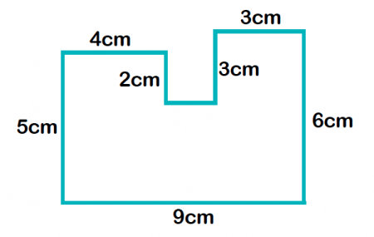
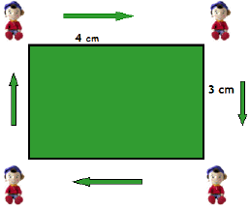
My Measurement
Interactive Notebook
Name
Class: 8-
Teacher: Mr Evans
Term 1 Semester 1

Slide 2
Contents
Glossary or Formula Page
Page
Date
Description
2

Slide 3
Tasks
24
7
30
Essential Question
Questions
Notes
Summary
6

Slide 4
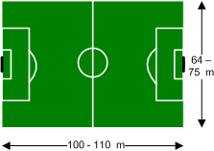
24
7
30
Topic: Perimeter
Date
Glossary
word
EQ – What is perimeter?
Perimeter
Is the distance along the boundary of a shape

Slide 5
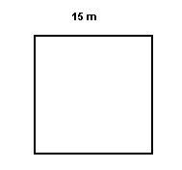
24
7
30
Topic: Perimeter
Date
EQ – How do we find the perimeter of different shapes?
Method
Perimeter
To find the perimeter we add up the lengths of the sides.
SQUARE

Slide 6
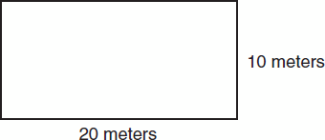
24
7
30
Topic: Perimeter
Date
EQ – How do we find the perimeter of different shapes?
How to find the perimeter
Perimeter
To find the perimeter we add up the lengths of the sides.
RECTANGLE

Slide 7
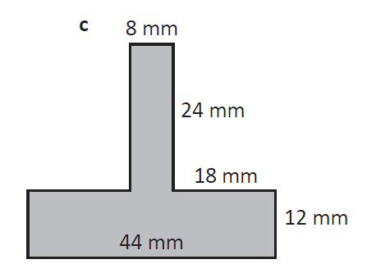
24
7
30
Topic: Perimeter
Date
EQ – How do we find the perimeter of different shapes?
How to find the perimeter
Perimeter
To find the perimeter we add up the lengths of the sides.
What do the lines mean???

Slide 8
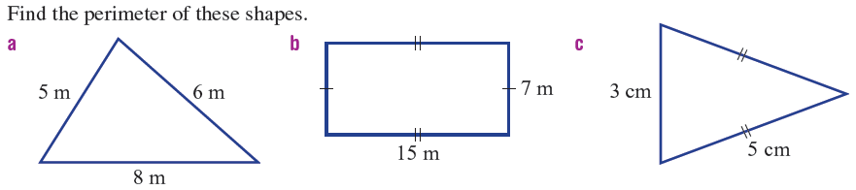
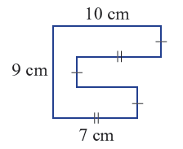
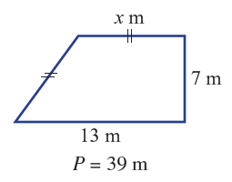

Slide 9
